Slide 1
time lapse of water depth decrease in resacas
Introduction to Scientific Computing for Earth, Environmental and Marine Science
Herman Ramsden

Slide 2
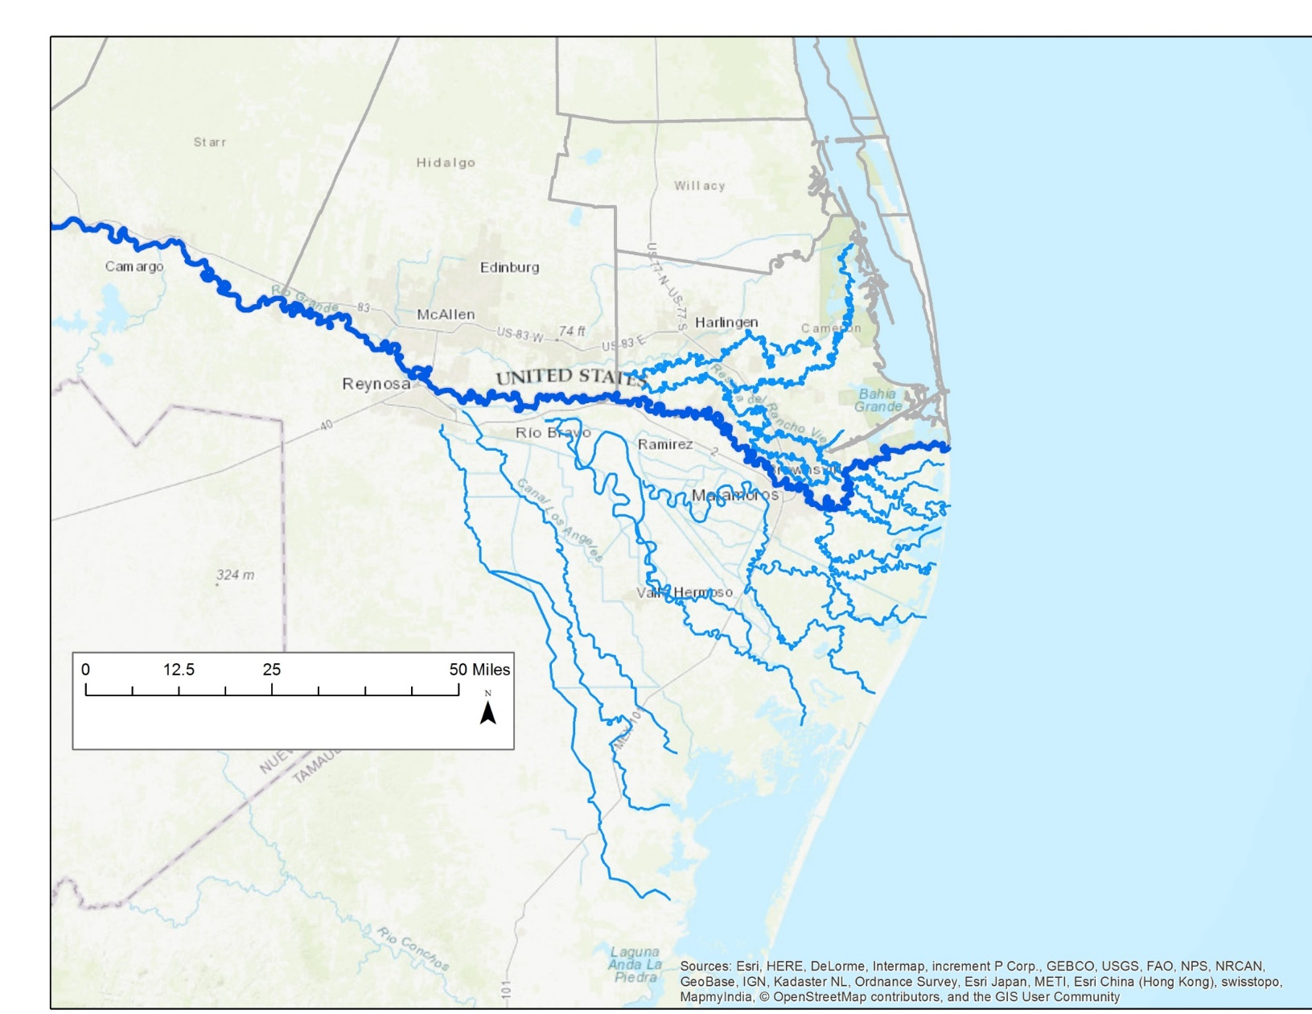
RIO GRANDE DELTA
Notes:
What are resacas? Resacas are distributaries of the Rio Grande

Slide 3
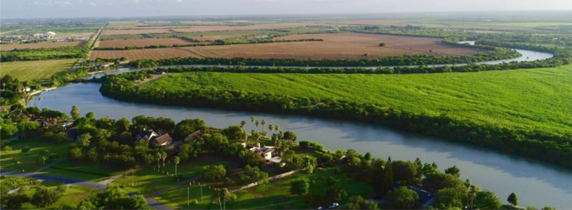
Resacas play vital roles in our study area
Flood protection.
Raw water storage.
Irrigation conveyance.
Habitat for bird / wildlife species.

Slide 4
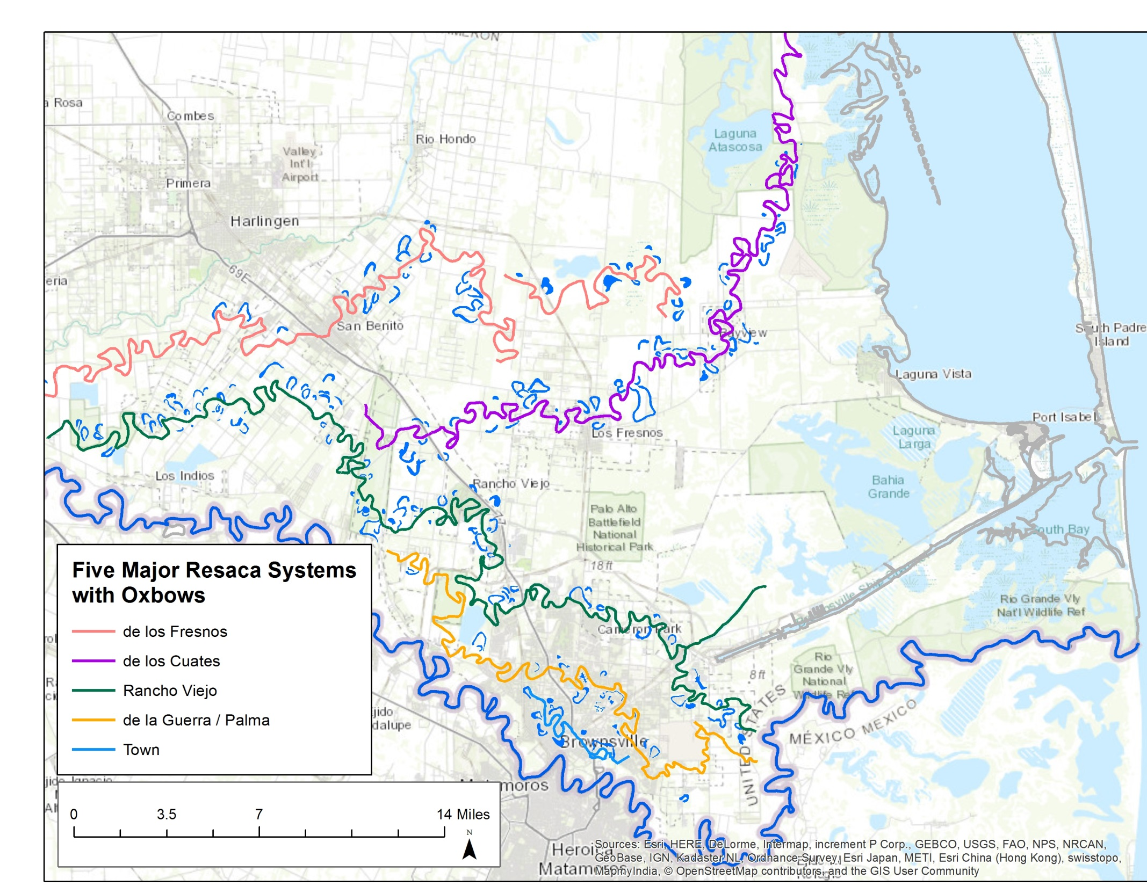
Notes:
As part of my project we created a GIS data base with the 5 major Resaca systems in Cameron County

Slide 5
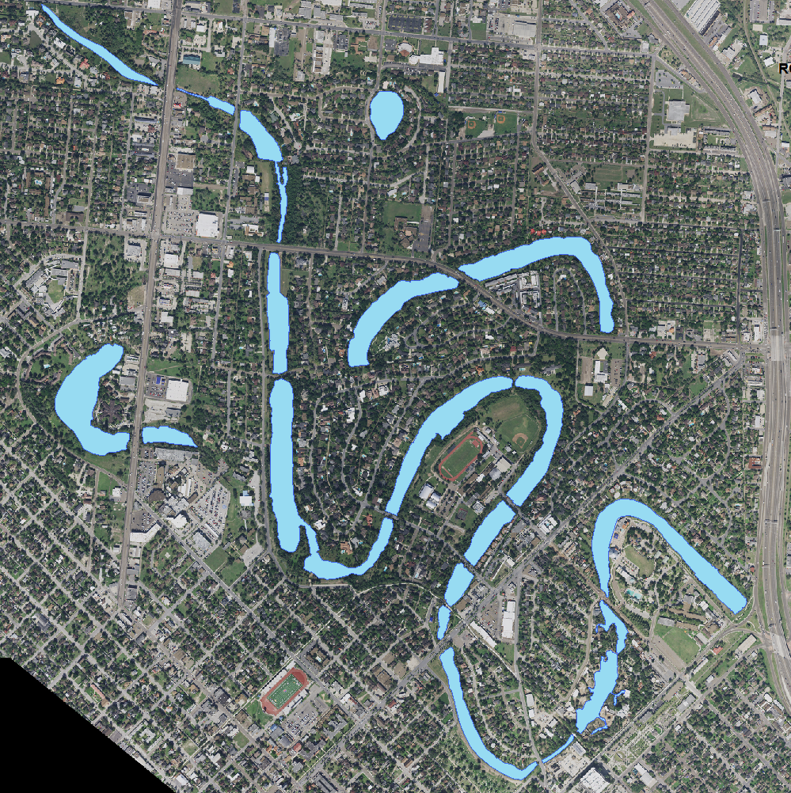
TOWN RESACA
Notes:
Sedimentation is higher because it serves as drainage for down town Brownsville

Slide 6
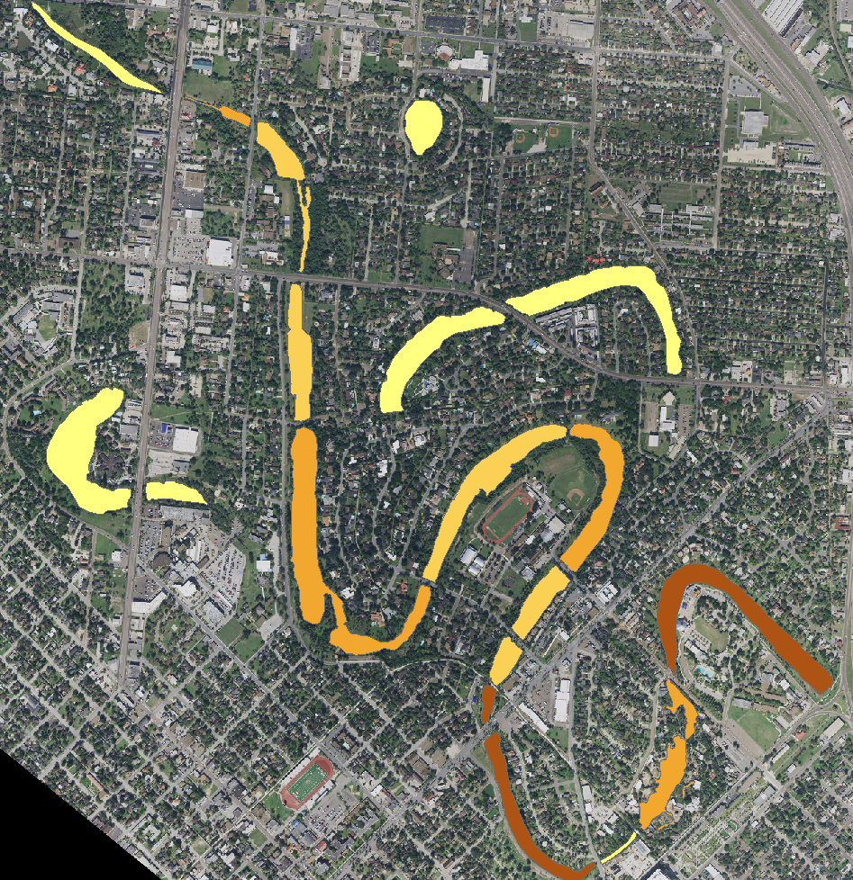
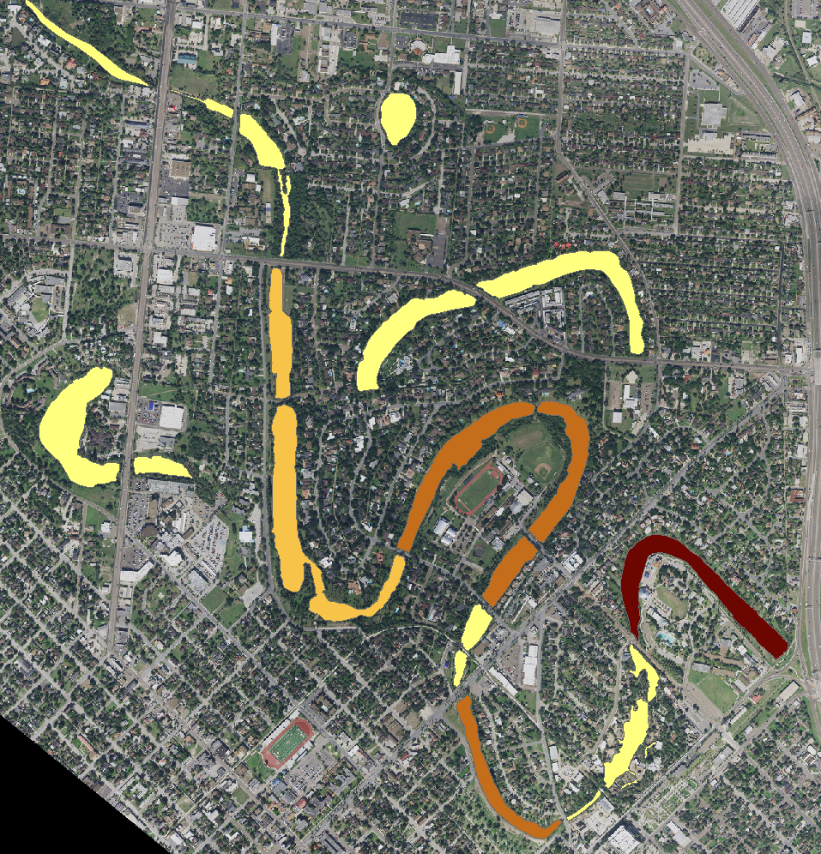
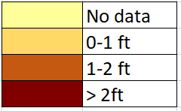
Sediment thickness data from 1976
Sediment thickness data from 2004
Notes:
From the 2 different data points we can calculate a sedimentation rate.
Sediment sources:
It comes in the water that’s pumped from the River
From the surrounding Watershed
Directed into the resacas through storm sewer network.
The ecosystem services that we talked about previously are deteriorated by increased sedimentation.
Dredging is extremely expensive
What I am doing in my thesis is to determine which factors have greater contribution to the sedimentation in resacas

Slide 7
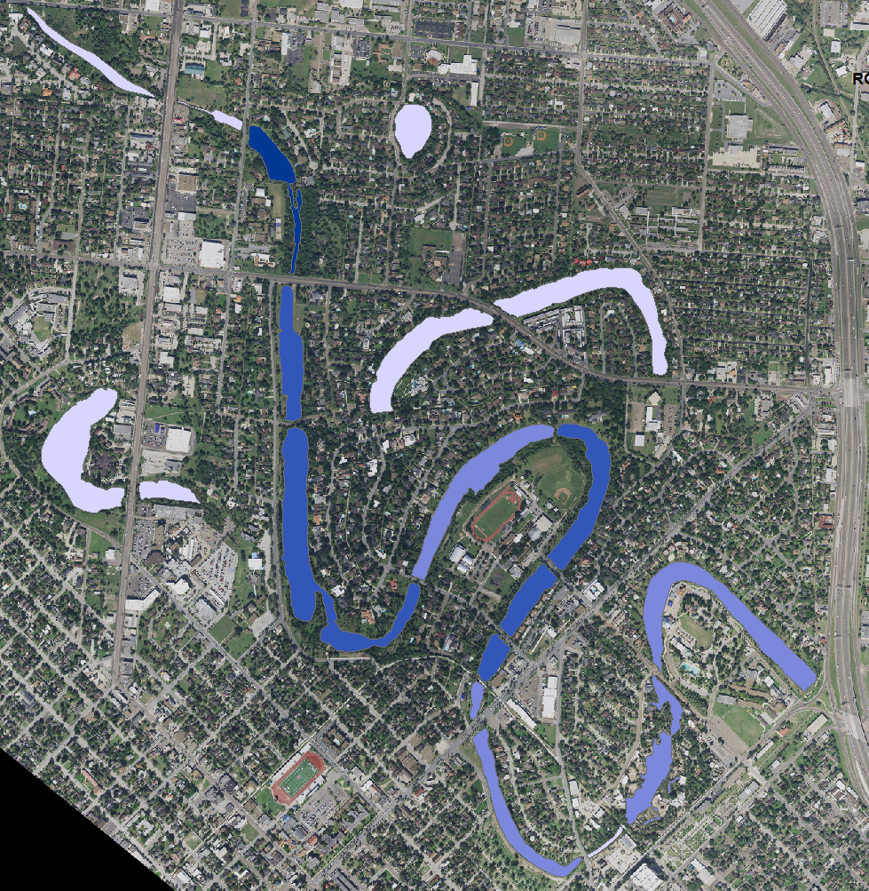
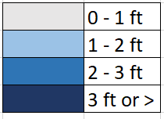
Water depth level in Resacas
Notes:
The water level is maintained by a system of hydraulic structures.

Slide 8
Calculations
YEAR | Water depth for an individual pool | Sediment rate for an induvial pool | New water depth for that pool.
2019 | 24 inches | 0.5 inches / year | 23.5 inches
2030 | 19.0 inches | 0.5 inches / year | 18.5 inches
2040 | 13.5 inches | 0.5 inches / year | 13.0 inches
2050 | 08.0 inches | 0.5 inches / year | 7.5 inches

Slide 9
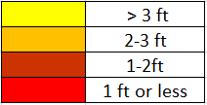
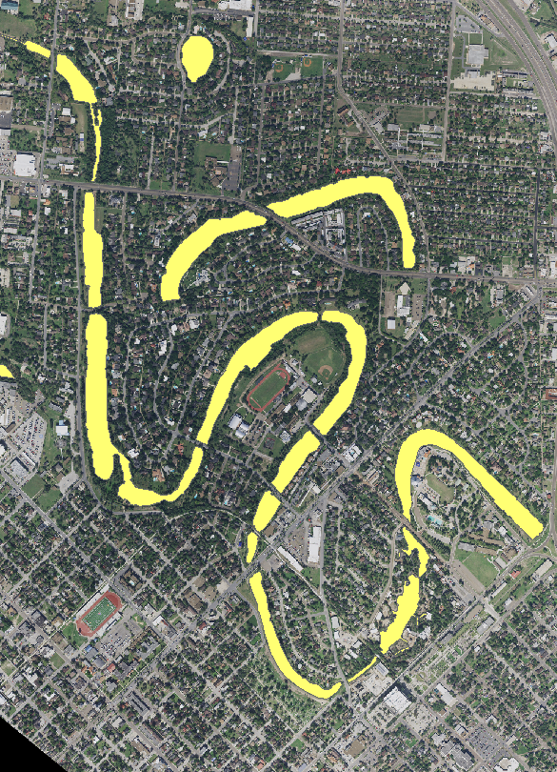
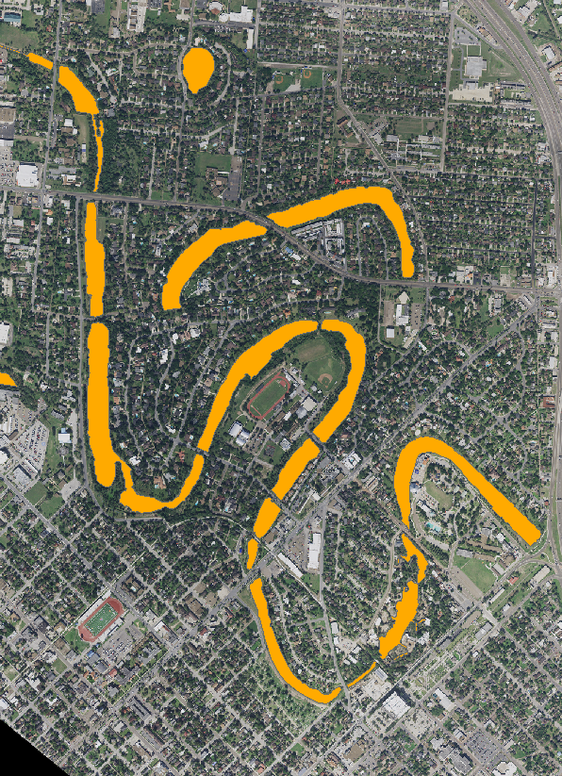
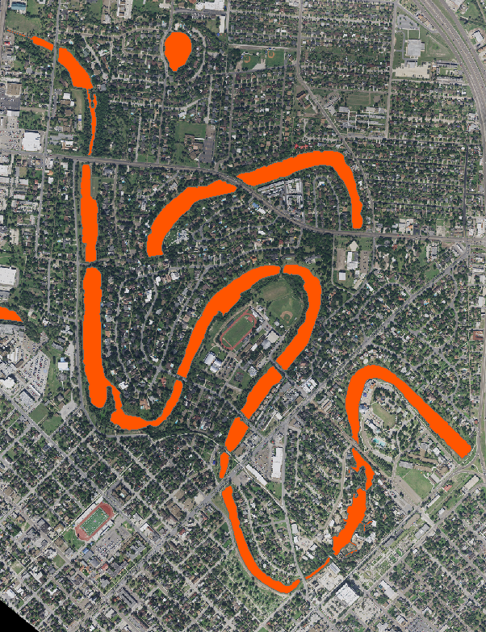
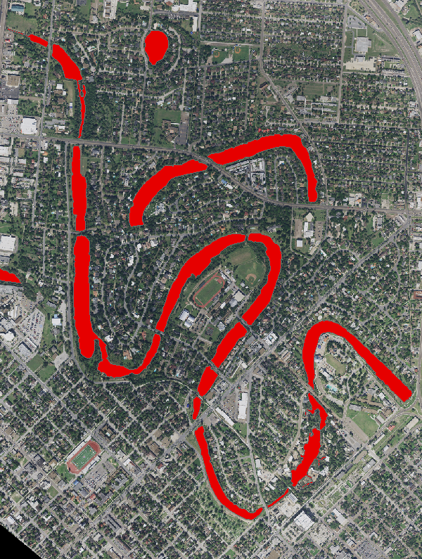
Expected outcome
Visualize how the water depth in each pool is changing over time. Since each pool has different sedimentation rates and different water depth levels. It would be nice to identify which pools are going to be filled up first with sediment, or have reduced water level and create a time lapse video
2019
2030
2040
2050

Slide 10
Thank you! questions!???

